Slide 1

Swift
By: Hamza Shahid & Ahmed Khan
CS 341

Slide 2

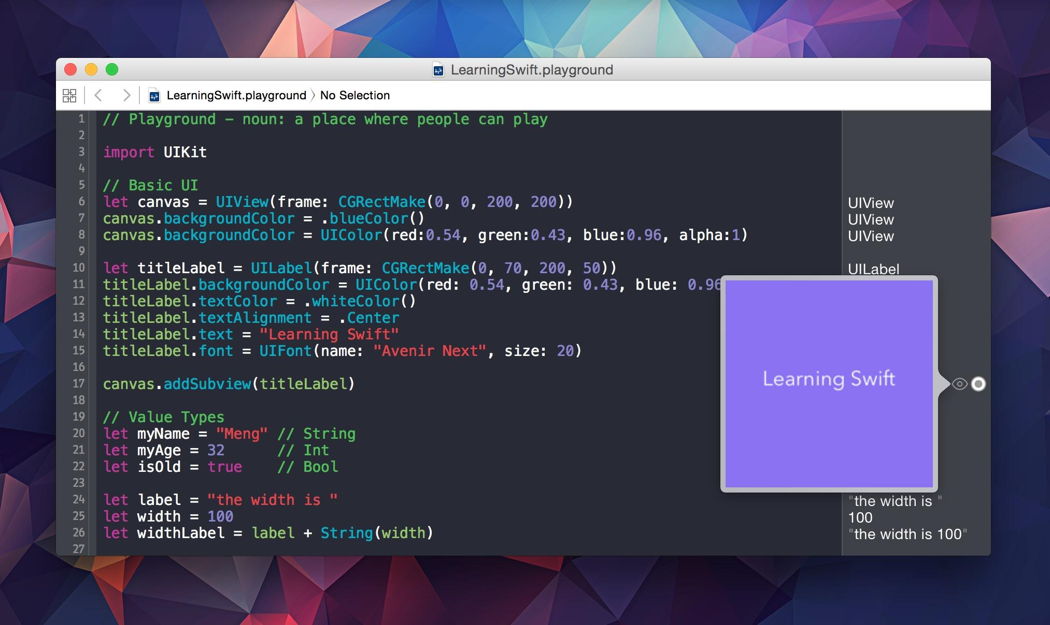

What EXACTLY is Swift?
Apple programming language - Chris Lattner - U of I grad
Used to create most Apple product applications
Publicly released on June 2, 2014 at AWDC
Objective-C preceded Swift

Slide 3

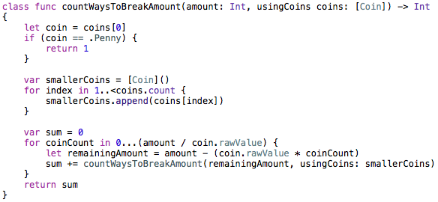
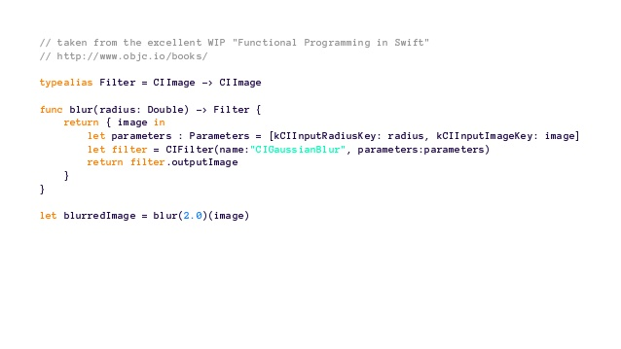
Swift Paradigms
Object-Oriented
Inherited from Objective-C
Imperative
(Somewhat) - mutable states
Functional
(Somewhat) - reduce, map functions

Slide 4
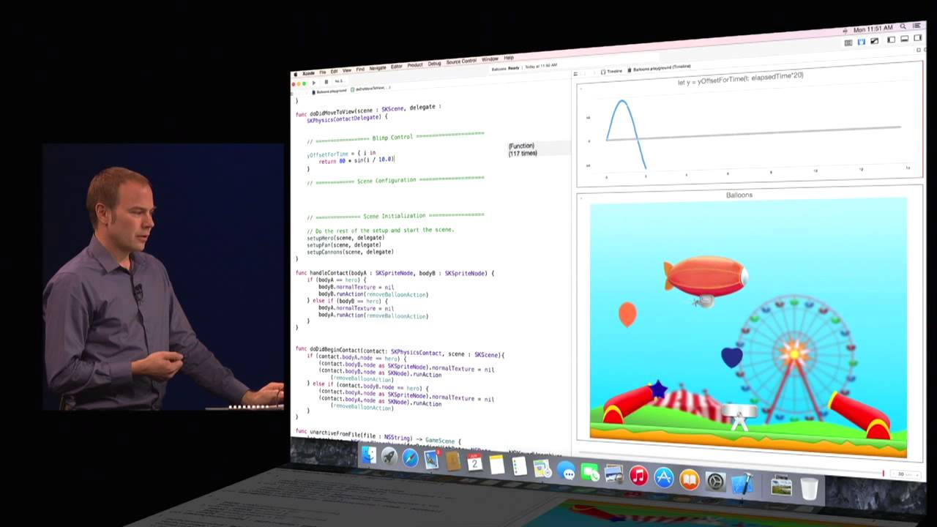
Key Features
Relatively easy to learn
Apple Exclusive Products
Playground
Write code and see the results simultaneously: Watch program run as you write

Slide 5
Key Features: Strong and Weak References
Weak Reference: deallocated by ARC (Automatic Reference Counting)
Strong Reference: Stops ARC from deallocating
Object being assigned to variable
Somewhat similar to Java’s garbage collector

Slide 6

Demo

Slide 7

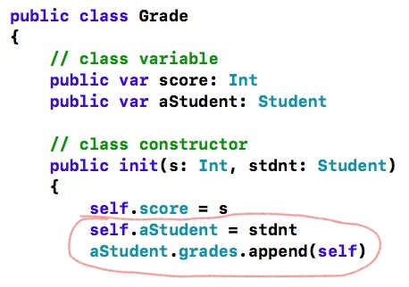


Strong/Weak Reference Visual
Student
Grade

Slide 8
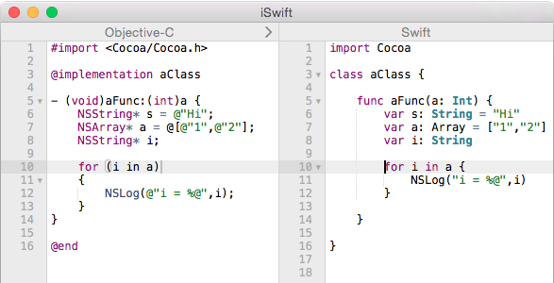
Swift vs Objective-C
Intended to improve Objective-C
Less code
Easier to read
Safer
Less error-prone

Slide 9

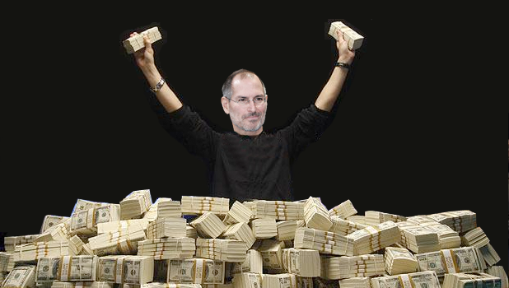
Pros/Cons
Pros
Safer than Objective-C
Versatile: readability of Python, speed of C++
Cons
Can only be used on a machine running OS X
Lack of backwards compatibility with older versions of the language - lots of time updating
Notes:
Manages null pointers easierly

Slide 10
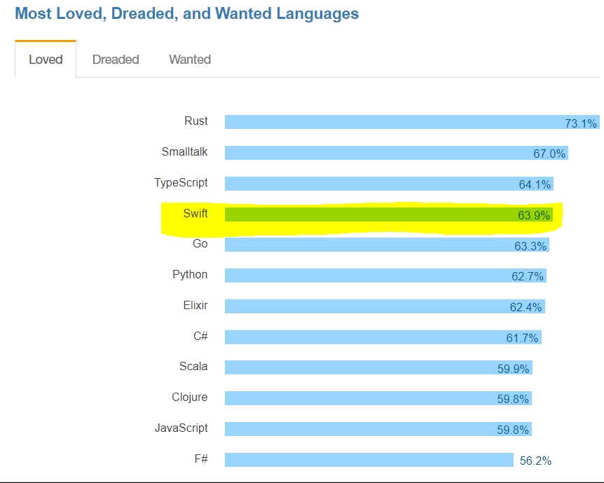
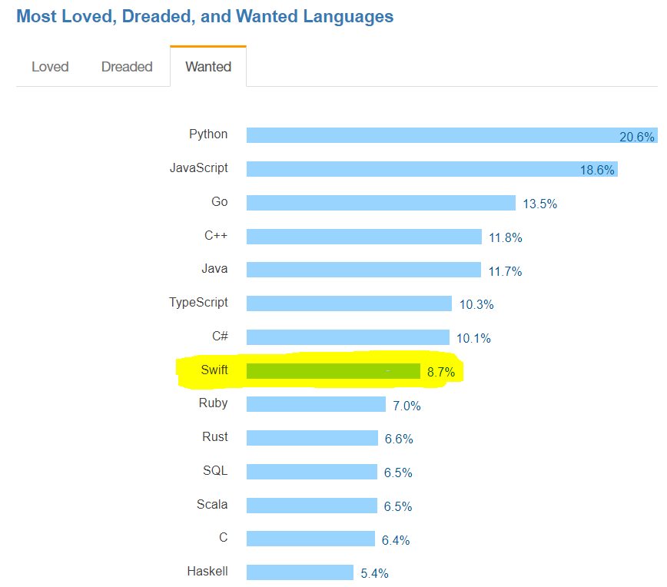
Interesting Stats
StackOverflow: Most Loved, Dreaded, and Wanted Languages, 2017 survey

Slide 11
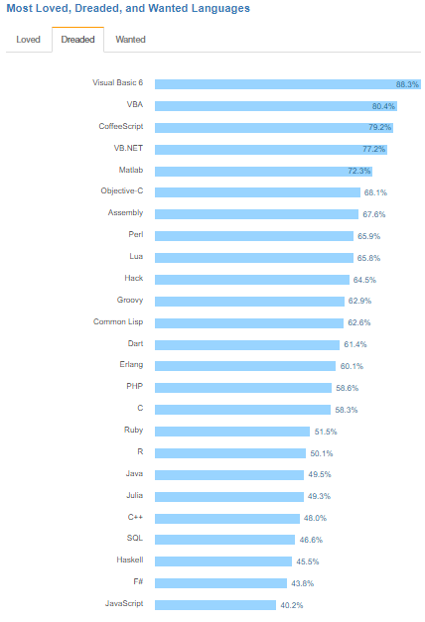
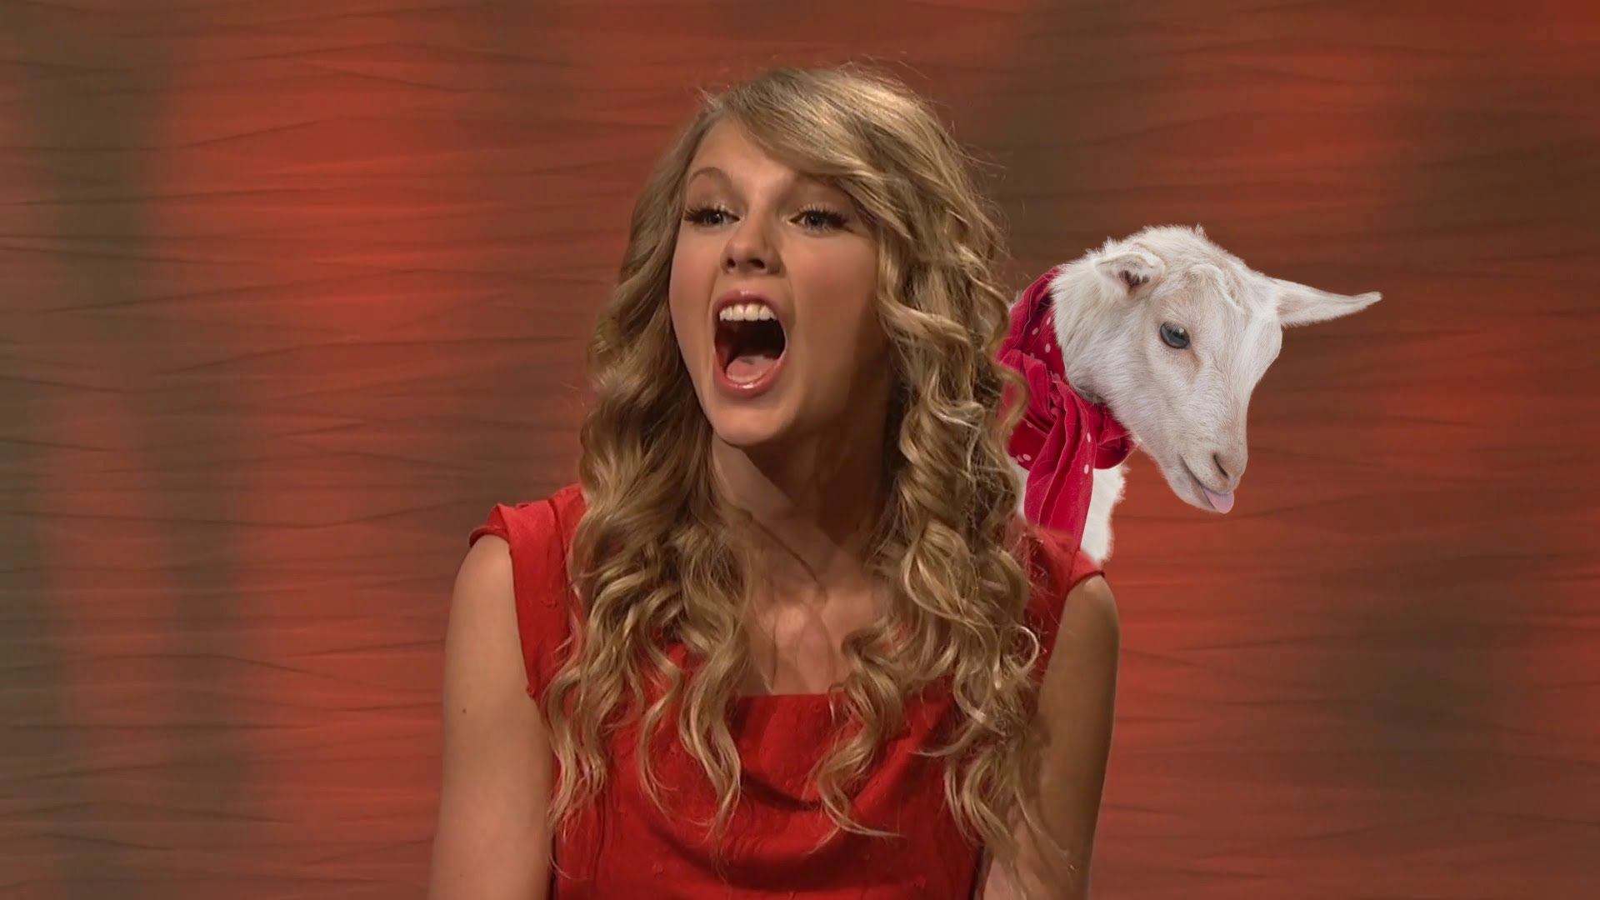


Taylor “Swift”

Slide 12
Done

Slide 13
References
https://insights.stackoverflow.com/survey/2017#most-loved-dreaded-and-wanted
https://stackoverflow.com/questions/26686132/what-languages-does-xcode-6-support
https://en.wikipedia.org/wiki/Swift_(programming_language)
https://www.quora.com/What-are-some-cool-things-about-Swift
https://skookum.com/blog/swift-blurs-the-lines-of-programming-paradigms
https://www.altexsoft.com/blog/engineering/the-good-and-the-bad-of-swift-programming-language/
https://cocoacasts.com/what-is-the-difference-between-strong-weak-and-unowned-references/

